Slide 2
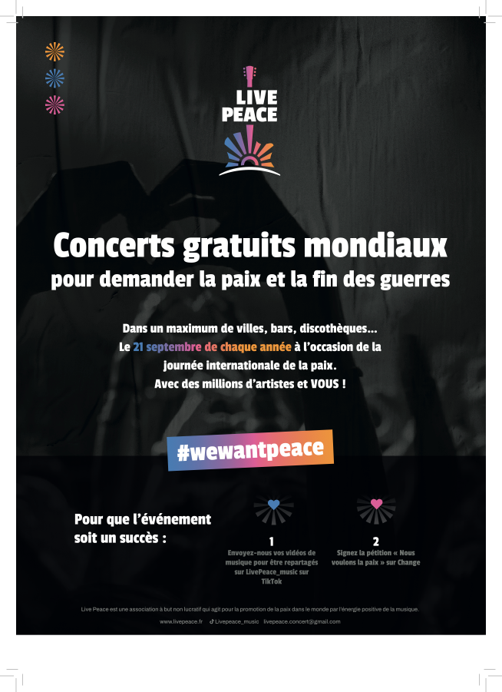

Slide 3
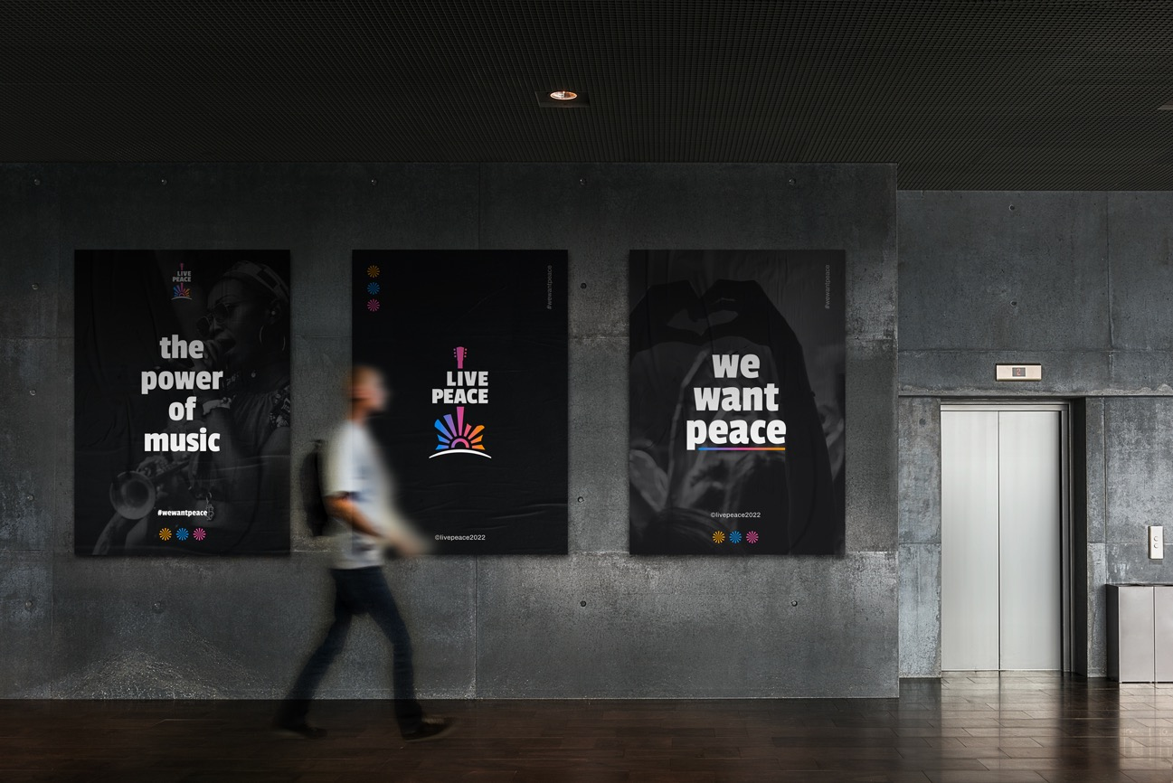

Slide 4
Live Peace®: mission statement
• More than 60 wars are raging around the world in 2022. It's enough!
• The power of music has always united people.
• Live Peace® is a global initiative for people to ask for peace and end to wars.
Our vision: thousands of local Live Peace musical events organized worldwide annually by local cities, bars, restaurants and night clubs each 21st of September, on the international day of peace of the UNO for millions of people to ask for peace through music.
Inspired by Live Aid mythic concerts and La fête de la musique

Slide 5
Live Peace® non profit association N° W751264720
Founding members:
Emmanuel Piegay, president of Live Peace.
Cathie Cusin, vice-president of MCI group.
David Guffroy, accountant associate at Eurex group.
Serge Luc, concert organiser
Frédéric Bedin, President of Hopscotch group.
Ralph Mogin, international DJ
In collaboration with
Christophe Lyard, entrepreneur in event industry
Jérôme Grosset-Janin, rallycross champion.
Christel Pernet, President les Puits du Désert
Catherine Leclerq, lawyer, Tosca avocats
Pascal Doucet-Bon, journalist at France TV

Slide 6
Key current corporate partners
Hopscotch groupe will take care of Public and Press relations and bring in event expertise.
MCI groupe will take care of social media relations and bring in event expertise.
Reworldmédia, leading media group, will bring free media planning
Livevent is involved in consulting
Iteractii, telemarketing agency, will support with telemarketers to involve key third parties
Electro Addict, DJ, is networking with international DJs
Idees techniques provides consulting in concerts’ organization
Jérôme Grosset-Janin is in charge of engaging sport ambassadors
Christel Pernet, President les Puits du Désert is involved in Public Relations
Leuz Diwan, musician, is involving African artists

Slide 7
Live Peace Tribune
Step 1
Tribune « call for action » to organize local Live Peace musical events worldwide on each 21st of September
To be signed by numerous international Mayors, Artists, Peace NGO’s, Music Festival, Peace Nobel Prizes…
To be sent to all major international media

Slide 8
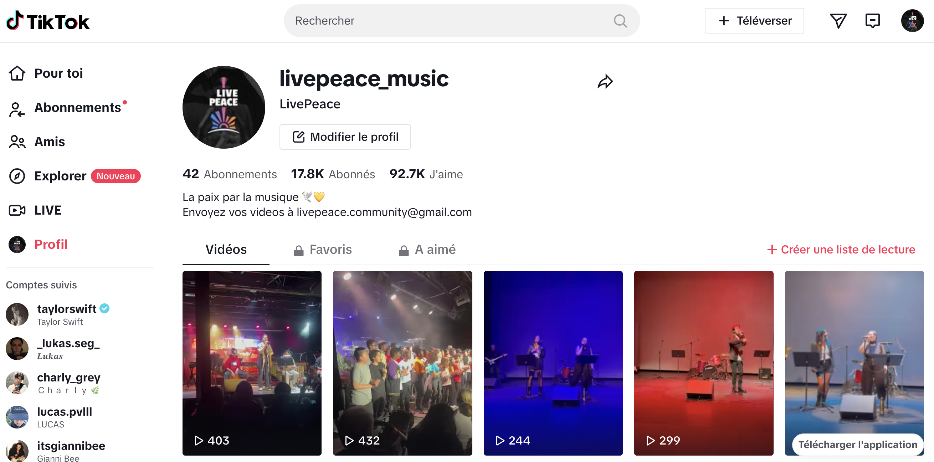
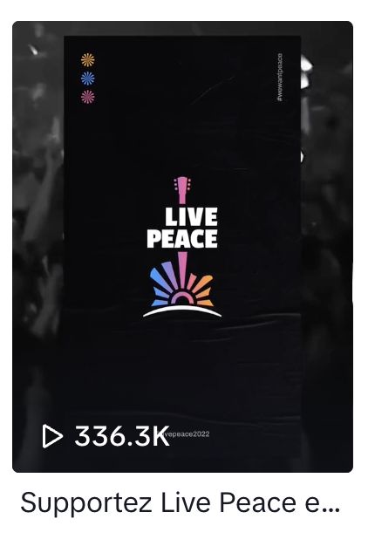
Live Peace Social Media
Musical video selfies of citizens to ask for peace on social medias

Slide 9
Live Peace Petition & branding
People are invited to sign the petition: « We want peace and an end to wars » .
If this petition exceeds 20 million signatures, it will become the most signed petition in history.
Artists and music festivals to display Live Peace logo on their communication to call for peace

Slide 10
Live Peace worldwide free local musical events
Step 2
Live Peace free simultaneous concerts in as many cities, bars, restaurants and night clubs as possible
Each 21st of September for the International day of Peace of the UNO

Slide 11
Live Peace 5 Continents
Step 3
1 major free concert per continent with international artists in cities such as Paris, Dakar, Beirut, New York, Tokyo, Rio de Janeiro…
Could take place within existing musical festivals
To be broadcasted by major international television channels
To be financed by sponsors
On 21st of September 2025 or 2026

Slide 12
Live Peace TV Show
1 day live show TV program each 21st of September
Starting in Japan, ending in US
Reportages about actions of local Peace NGO’s
Broadcast of Live Peace musical events around the world

Slide 13
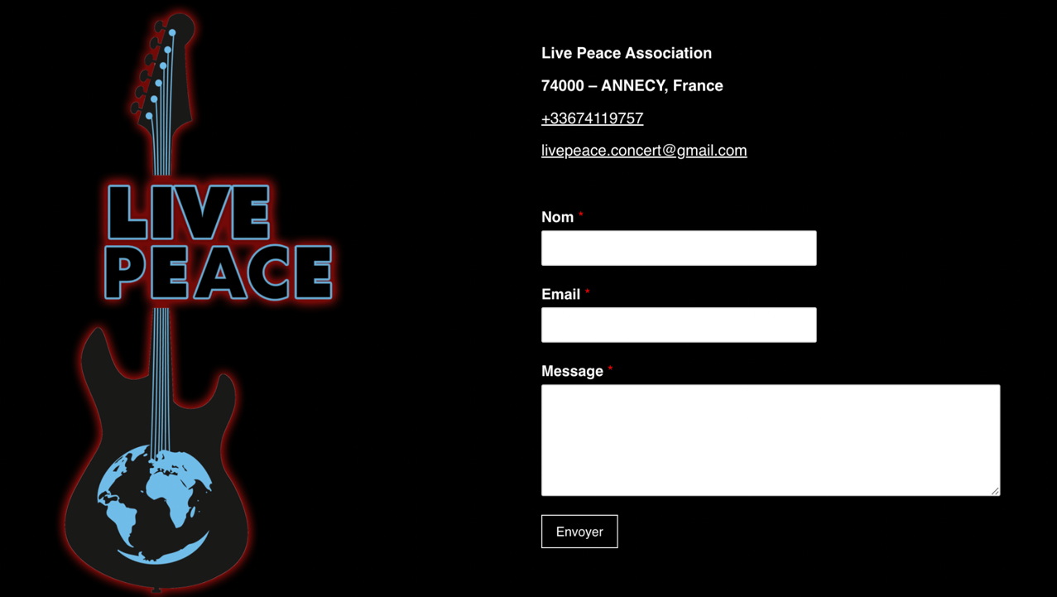
25 rue Notre dame des Victoires 75 002 Paris - France

